Slide 1
Data warehousing
Introduction

Slide 2
What is a Data Warehouse?
A Data Warehousing (DW) is process for collecting and managing data from varied sources to provide meaningful business insights.
A Data warehouse is typically used to connect and analyze business data from heterogeneous sources.
The data warehouse is the core of the BI system which is built for data analysis and reporting.

Slide 3
Database vs Data warehouse: differences
Database is a collection of related data that represents some elements of the real world, whereas Data warehouse is an information system that stores historical and commutative data from single or multiple sources.
Database is designed to record data whereas the Data warehouse is designed to analyze data.
Database is application-oriented-collection of data whereas Data Warehouse is the subject-oriented collection of data.
Database uses Online Transactional Processing (OLTP) whereas Data warehouse uses Online Analytical Processing (OLAP).
ER modeling techniques are used for designing Database whereas data modeling techniques are used for designing Data Warehouse.

Slide 4
Merits & limitations of data warehouse
Delivers Enhanced Business Intelligence
Ensures Data Quality and Consistency
Saves Time and Money
Tracks Historically Intelligent Data
Generates high ROI
Extra Report Work
Inflexibility and homogenization of data
Ownership Concerns
Demands for large amounts of resources
Hidden issues consume time

Slide 5
Characteristics of DWs
Subject oriented
Integrated
Time-variant (time series)
Nonvolatile
Summarized
Not normalized
Metadata
Web based, relational/multidimensional
Client/server, real-time/right-time/active.

Slide 6
Subject-Oriented
A data warehouse is subject oriented as it offers information regarding a theme instead of companies' ongoing operations. These subjects can be sales, marketing, distributions, etc.
A data warehouse never focuses on the ongoing operations. Instead, it put emphasis on modeling and analysis of data for decision making.

Slide 7
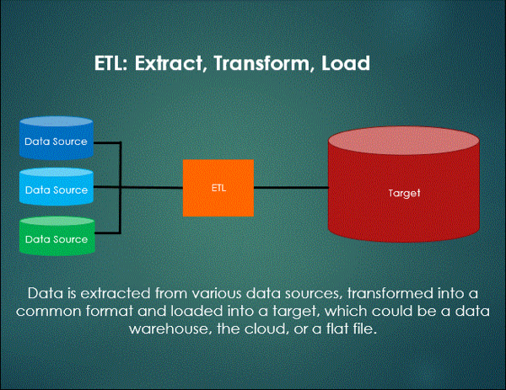
Integrated
In Data Warehouse, integration means the establishment of a common unit of measure for all similar data from the dissimilar database. The data also needs to be stored in the Data warehouse in common and universally acceptable manner.

Slide 8
Time-Variant
The time horizon for data warehouse is quite extensive compared with operational systems. The data collected in a data warehouse is recognized with a particular period and offers information from the historical point of view. It contains an element of time, explicitly or implicitly.
Another aspect of time variance is that once data is inserted in the warehouse, it can't be updated or changed.

Slide 9
Non-volatile
Data warehouse is also non-volatile means the previous data is not erased when new data is entered in it.
Activities like delete, update, and insert which are performed in an operational application environment are omitted in Data warehouse environment. Only two types of data operations performed in the Data Warehousing are:
Data loading
Data access

Slide 10
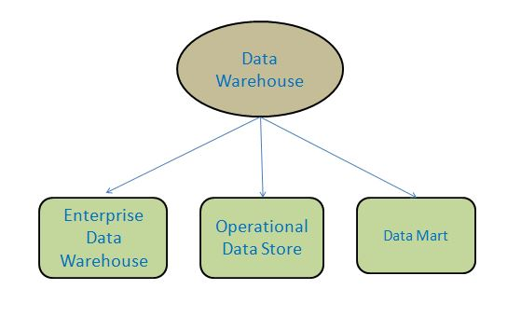
Types of Data Warehouse

Slide 11
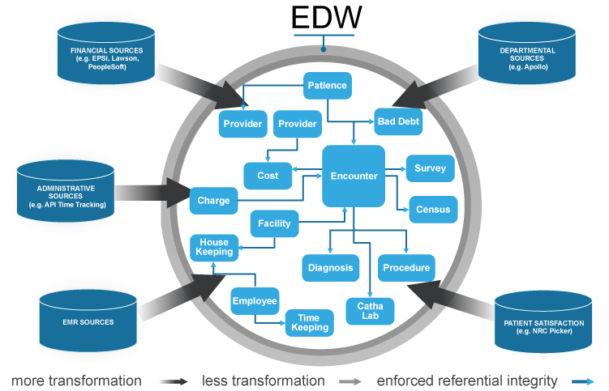
1. Enterprise Data Warehouse
Is a centralized warehouse.
Provides decision support service across the enterprise.
Offers a unified approach for organizing and representing data.
It provides the ability to classify data according to the subject and give access according to those divisions.

Slide 12
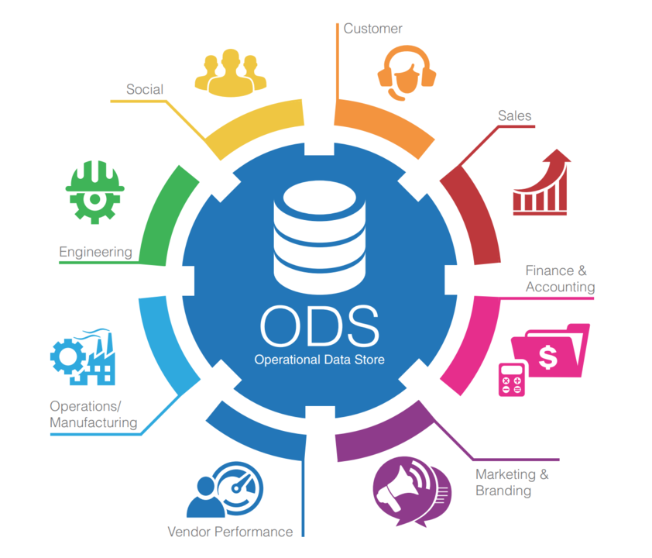
2. Operational Data Store
Operational Data Store is data store required when neither Data warehouse nor OLTP systems support organizations reporting needs.
In ODS, Data warehouse is refreshed in real time.
It is widely preferred for routine activities like storing records of the Employees.

Slide 13
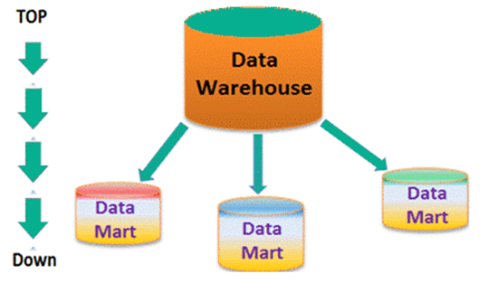
3. Data Mart
A data mart is a subset of the data warehouse.
In an independent data mart, data can collect directly from sources.
The data in each data mart stays separate, in its own system
Data marts are fast and easy to use, as they make use of small amounts of data.

Slide 14
Data Warehouse Tools
There are many Data Warehousing tools are available in the market. Here, are some most prominent one:
IBM Datastage
Oracle
Amazon RedShift
SAP
Google BigQuery
DOMO
And many more...

Slide 15
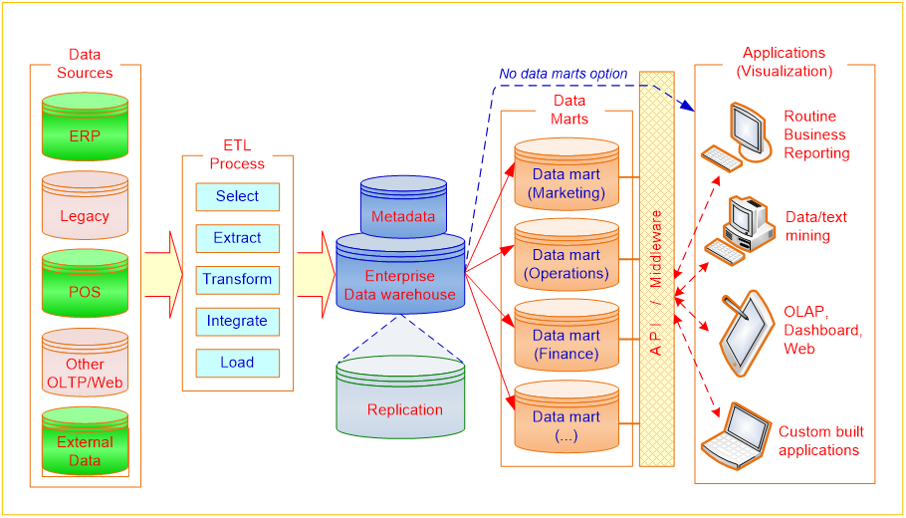
Overall DW Process

Slide 16
Data Warehouse Architectures
Single-tier architecture: The objective of a single layer is to minimize the amount of data stored. This goal is to remove data redundancy. This architecture is not frequently used in practice.
Two-tier architecture: Two-layer architecture separates physically available sources and data warehouse. This architecture is not expandable and also not supporting a large number of end-users. It also has connectivity problems because of network limitations.
Three-tier architecture: This is the most widely used architecture.

Slide 17
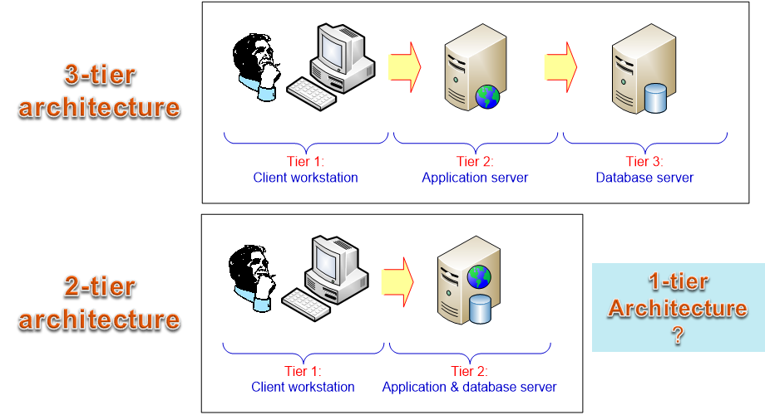
Data Warehouse Architectures

Slide 18
DW Architecture Selection Decision
Information interdependence between organizational units
Upper management’s information needs
Urgency of need for a data warehouse
Nature of end-user tasks
Constraints on resources
Strategic view of the data warehouse prior to implementation
Compatibility with existing systems
Perceived ability of the in-house IT staff
Technical issues
Social/political factors

Slide 19
Task
Connect to the cloud databases.
Explore the coursework database.
What queries do we run to explore data?

